Slide 1
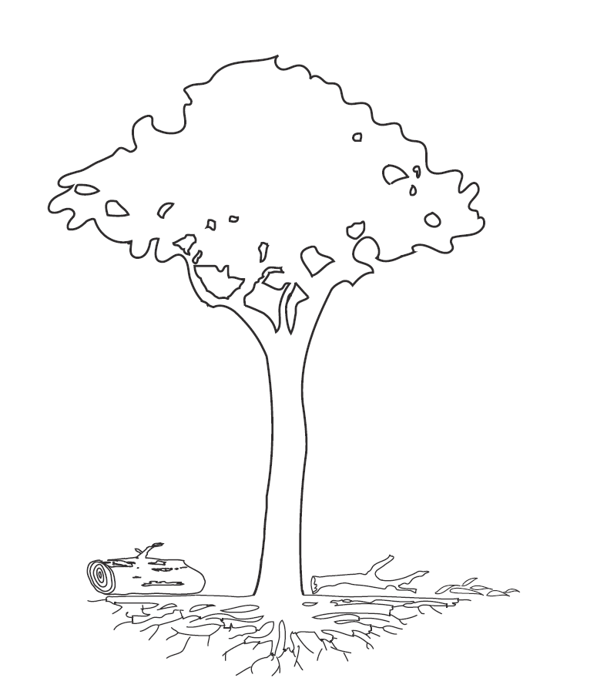
Manaus, Central Amazonia
GPP = 30.4±4.0; GPP_{tower} = 30.4
Malhi et al. 2009
Global Change Biology
NPP_{Total} = 10.1±1.4
NPP_{Ag} = 7.3±1.3
NPP_{Bg} = 2.8±0.7
NPP _{leaves,flowers,fruit} = 3.6±0.7
NPP _{VOC} = 0.13±0.06
R _{leaf} = 10.0±4.0
NPP _{branch turnover} = 1.0±1.0
R _{stem} = 4.2±1.0
D_{Fine litterfall} = 3.6±0.7
NPP _{stem} = 2.58±0.06
Predicted R _{soil} = 12.6±2.3
Measured R _{soil} = 12.1±1.7
R _{CWD} = 2.5±0.3
D_{CWD}= 3.58±1.0
R _{roots} = 5.6±2.0
NPP _{coarse roots} = 0.8±0.2
NPP _{fine roots} = 2.1±0.7
D_{Root} = 2.8±0.7
R _{soil het.} = 7.1±1.1
F_{doc} = 0.19±0.07
Notes:
Cross checks 1 respiration; 2 flux towers

Slide 2
Notes:
Cross checks 1 respiration; 2 flux towers

Slide 3
Notes:
Cross checks 1 respiration; 2 flux towers

